Slide 1
ZOMATO RESTAURANT ANALYTICS
PROJECT
PROJECT ID : P1376
TEAM MEMBERS : SANJIVANI MESHRAM
SAKSHI JIWTODE
GAIKWAD VAISHALI
ANANYA T S
JANAVI R

Slide 2
TABLE OF CONTENT
1. PROJECT INTRODUCTION
2. PROJECT OBJECTIVES
3. DATA CLEANING & PREPROCESSING
4. ZOMATO RESTAURANT KPIs
5. EXCEL DASHBOARD
6. SQL KPI QUERIES
7. TABLEAU DASHBOARD
8. POWER BI DASHBOARD
9. WHAT WE LEARNED
10. KEY INSIGHTS
11. CONCLUSION

Slide 3
PROJECT INTRODUCTION
Zomato Restaurant Analytics is a data analysis project focused on identifying trends and insights from restaurant data. The dataset includes information about restaurants, cuisines, ratings, pricing, locations, and services. Excel, SQL, Tableau, and Power BI were used for analysis and visualization.

Slide 4
PROJECT OBJECTIVES
Analyze the distribution of restaurants across different cities.
Study restaurant ratings and pricing patterns.
Analyze online delivery and table booking availability.
Identify the most common cuisines.
Analyze restaurant openings over the years.
Create interactive dashboards for better decision-making.
Extract meaningful insights from the restaurant dataset.

Slide 5
DATA CLEANING & PREPROCESSING
Removed or handled missing values.
Checked duplicate and inconsistent records.
Standardized data formats.
Converted data into suitable numeric and categorical formats.
Created calculated fields required for KPIs and dashboard visualizations.
Prepared the final dataset for Excel, SQL, Tableau, and Power BI analysis.

Slide 6
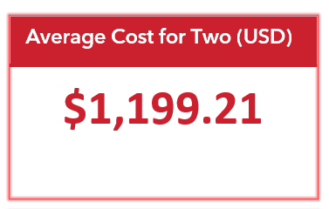
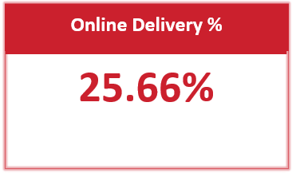
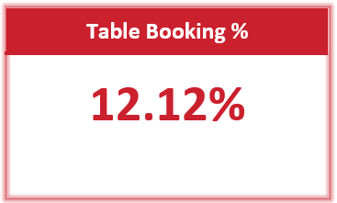
ZOMATO RESTAURANT KPIs
This KPI represents the average amount spent by two people at a restaurant, converted into US dollars. It helps us understand the general pricing level of restaurants.
This shows the percentage of restaurants that provide online food delivery services.
This shows the percentage of restaurants that provide table-booking facilities.

Slide 7
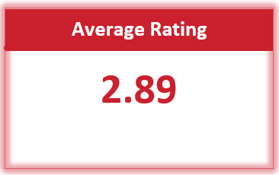
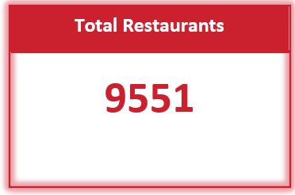
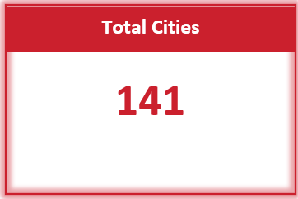
This shows the average customer rating of all restaurants in the dataset. It helps us understand the overall customer satisfaction level.
This KPI shows the total number of restaurants available in the dataset. It gives us an overall idea of the size of the restaurant data we analyzed.
This KPI shows the number of unique cities represented in the dataset. It indicates the geographical coverage of the restaurants.

Slide 8
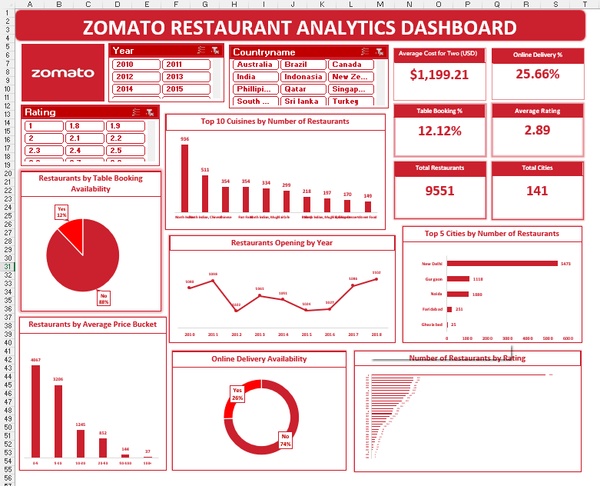
EXCEL DASHBOARD
Excel was used for data preparation, calculations, and initial analysis. We used PivotTables, PivotCharts, calculated columns, and slicers to organize the data and create an interactive dashboard.

Slide 9
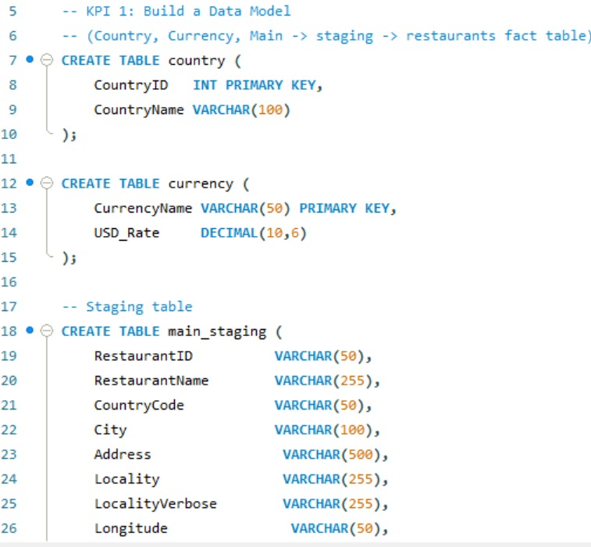
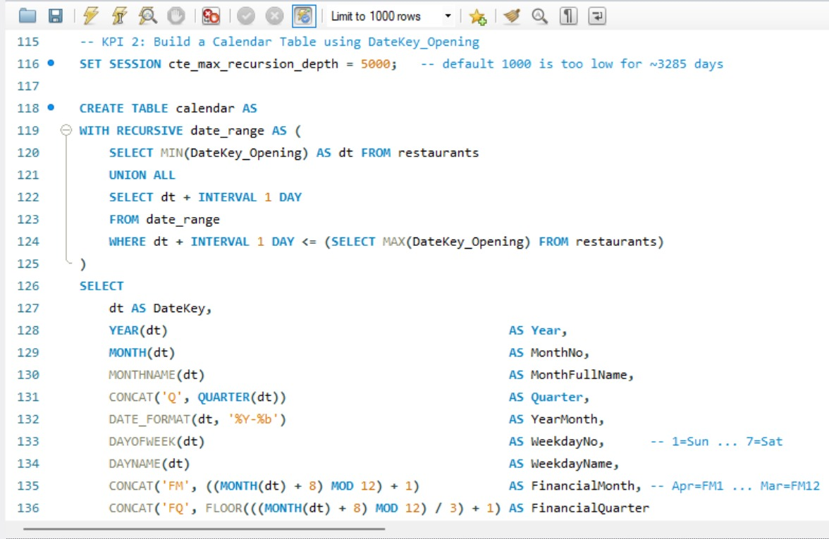
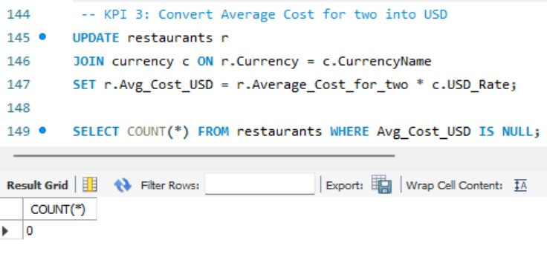
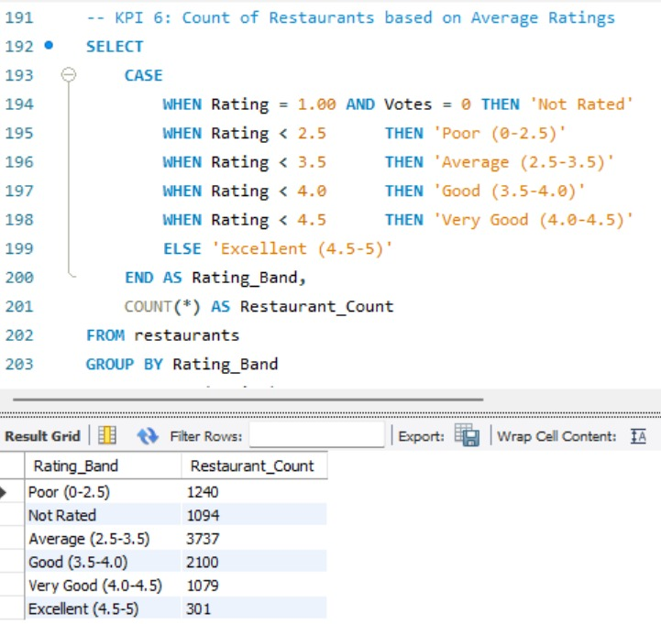
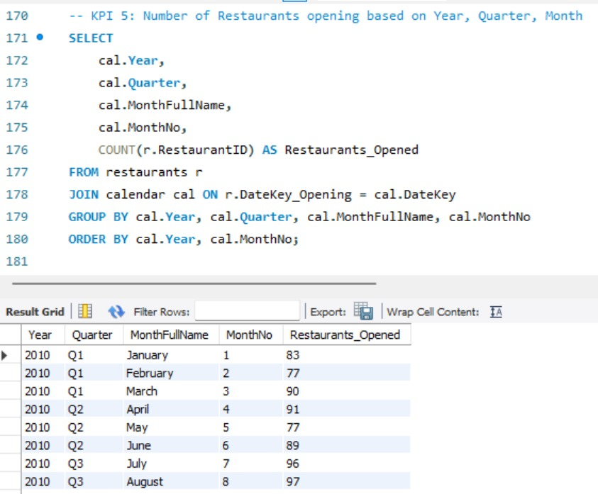
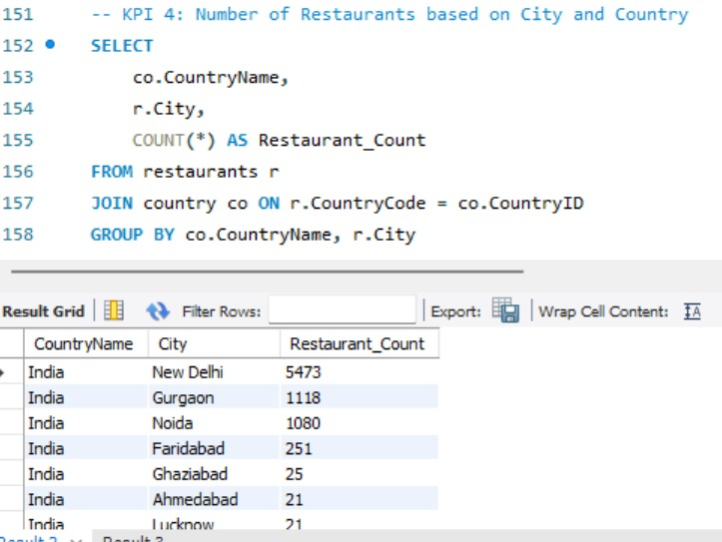
SQL KPI QUERIES

Slide 10
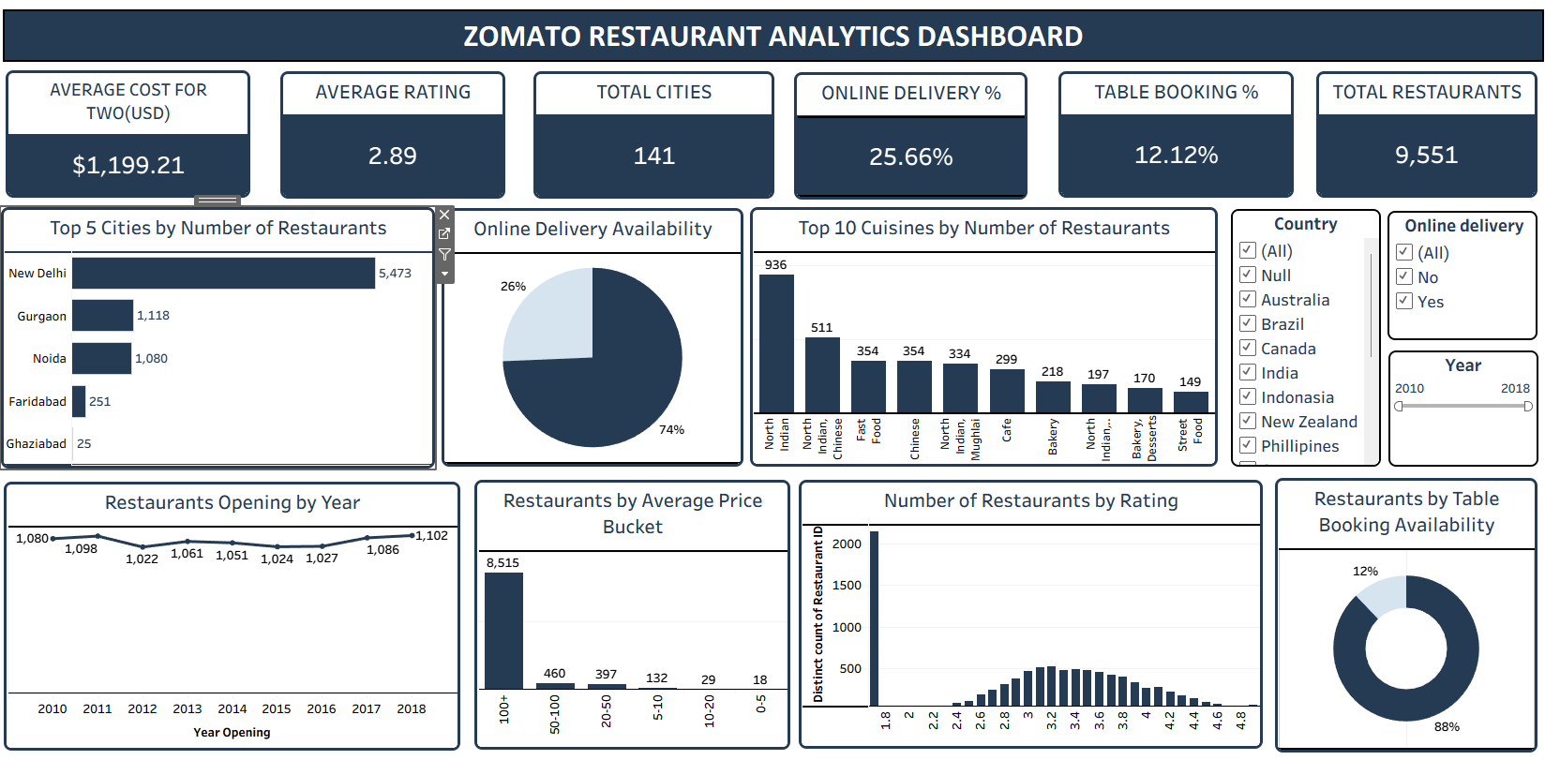
TABLEAU DASHBOARD
Tableau was used to create highly interactive and visually engaging dashboards. We used calculated fields, filters, and different chart types to explore patterns and trends in the restaurant data.

Slide 11
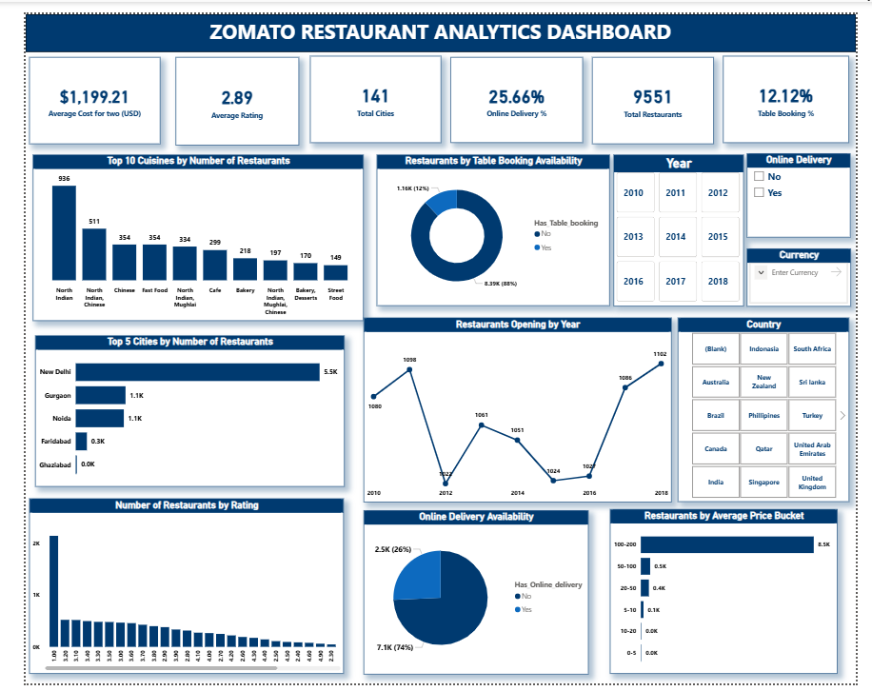
POWER BI DASHBOARD
Power BI was used to transform the analysis into a more interactive and professional business dashboard. We created DAX measures, interactive visuals, KPI cards, and slicers to explore the restaurant data dynamically.

Slide 12
WHAT WE LEARNED
How to clean and prepare real-world datasets.
How to calculate and interpret KPIs.
How to use SQL for data analysis.
How to create meaningful charts and visualizations.
How to build interactive dashboards using Excel, Power BI, and Tableau.
How filters and slicers help users explore data interactively.
How to identify trends and business insights from data.
How data analysis can support better decision-making.

Slide 13
KEY INSIGHTS
New Delhi has the highest number of restaurants among the top cities analyzed.
North Indian is the most common cuisine in the dataset.
Around 25.66% of restaurants offer online delivery.
Around 12.12% of restaurants provide table-booking facilities.
Restaurant openings remained fairly stable between 2010 and 2018.
Most restaurant ratings are concentrated around the 3.0–3.5 range.
The dataset covers 9,551 restaurants across 141 cities.

Slide 14
CONCLUSION
The Zomato Restaurant Analytics project helped us transform raw restaurant data into meaningful insights using Excel, SQL, Power BI, and Tableau. Through data cleaning, analysis, KPIs, and interactive dashboards, we were able to understand restaurant distribution, customer ratings, pricing, cuisines, and service availability. This project strengthened our practical skills in data analysis and visualization.

Slide 15

THANK YOU

